Slide 1
Semantic Segmentation of Key Body Extremities through Topological Analysis of Fused 3D data
Notes:
The second stage of proposed framework localizes and identifies the key body extremities such as head, hands, and feet. It also illustrates the method of generating a topological hierarchical skeleton tree graph. The skeleton tree graph + labelling will be useful for pose recognition.

Slide 2
Detection of Feature Extremity
3D Topological Hierarchical Segmentation and Skeleton Generation
Classification of Key Body Extremities
Notes:
Consists of three

Slide 3
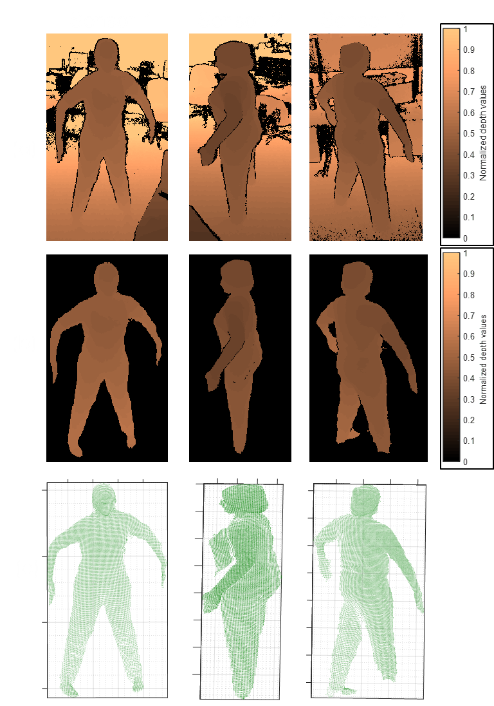
Pre-Processing
Background subtraction
Filtering
Notes:
The beginning part of this stage conducts Preprocessing of depth data from multiple sensor and then extraction of point clouds

Slide 4
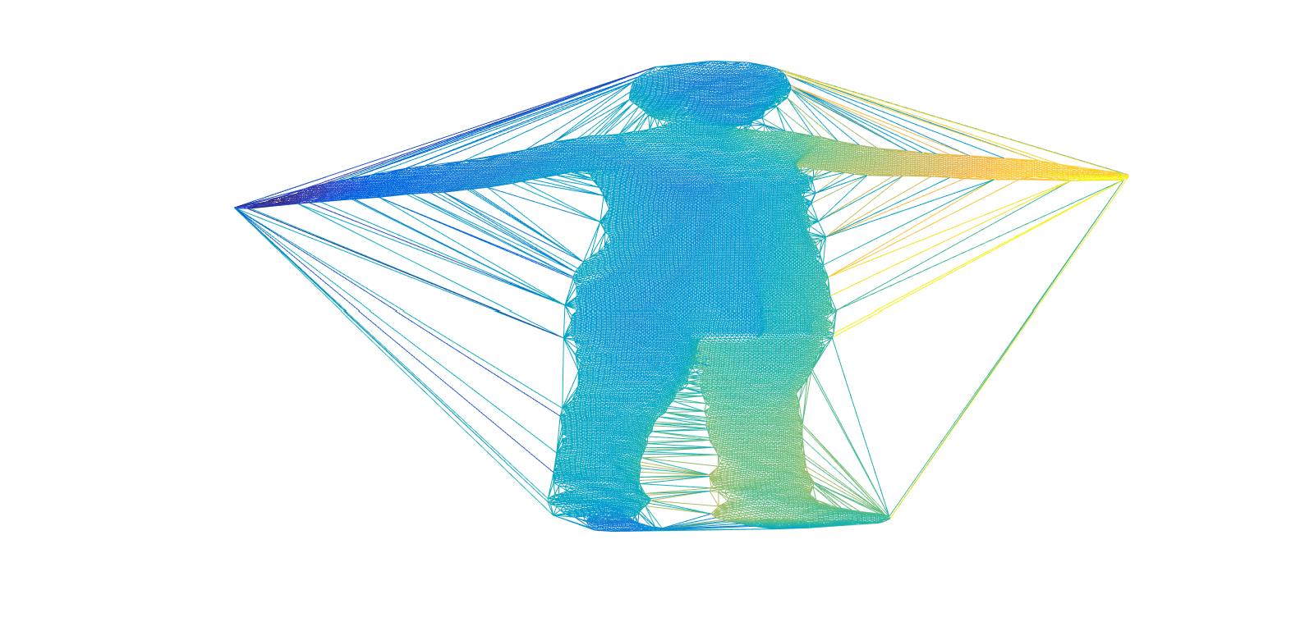
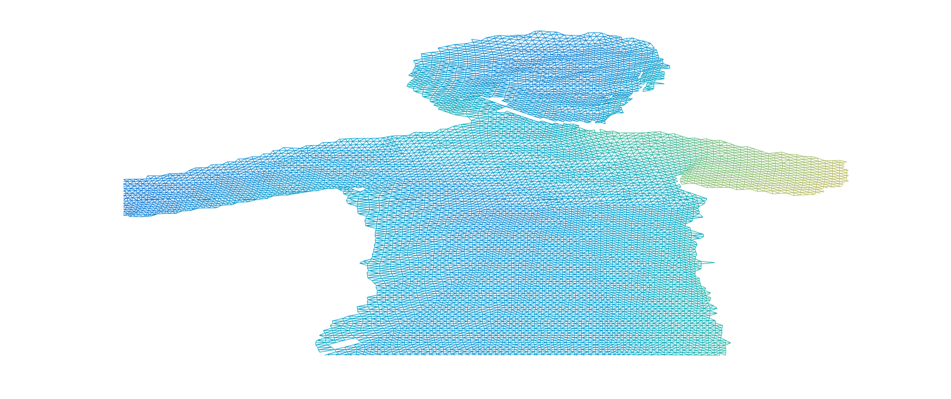
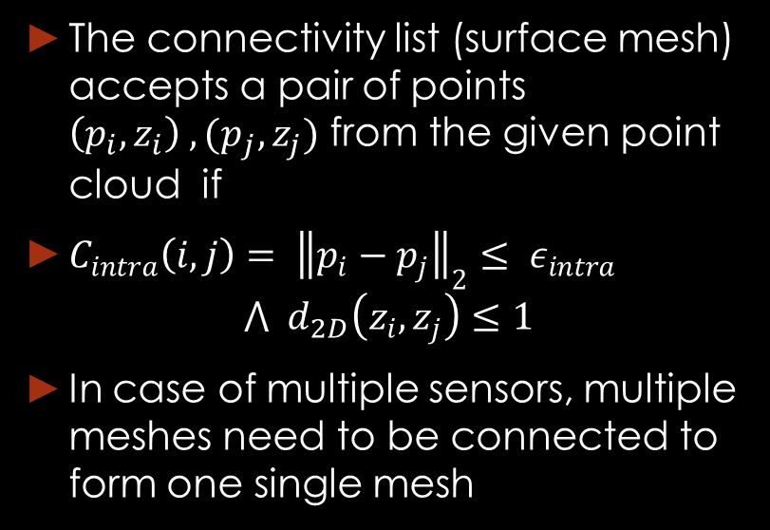
Generation of Intra-Connectivity in Each Point Cloud Sensor Data
The connectivity list (surface mesh) accepts a pair of points $\left(p_{i},z_{i}\right) ,(p_{j},z_{j})$ from the given point cloud if
$C_{intra}\left(i,j\right)= {\left\|p_{i}−p_{j}\right\|}_{2}≤ ε_{intra}$
$$⋀ d_{2D}\left(z_{i},z_{j}\right)≤1$$
In case of multiple sensors, multiple meshes need to be connected to form one single mesh
Initial generated 3D Mesh Surface
Mesh Points with relevant edges
Notes:
On these point clouds, a surface mesh is formed which satisfies this intra-connectivity criterion

Slide 5
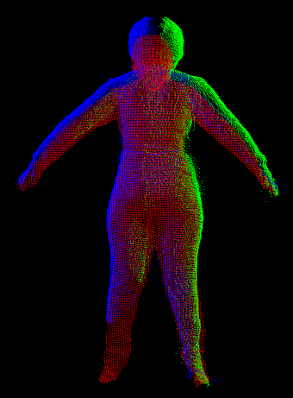
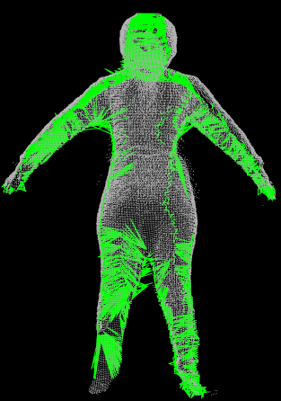
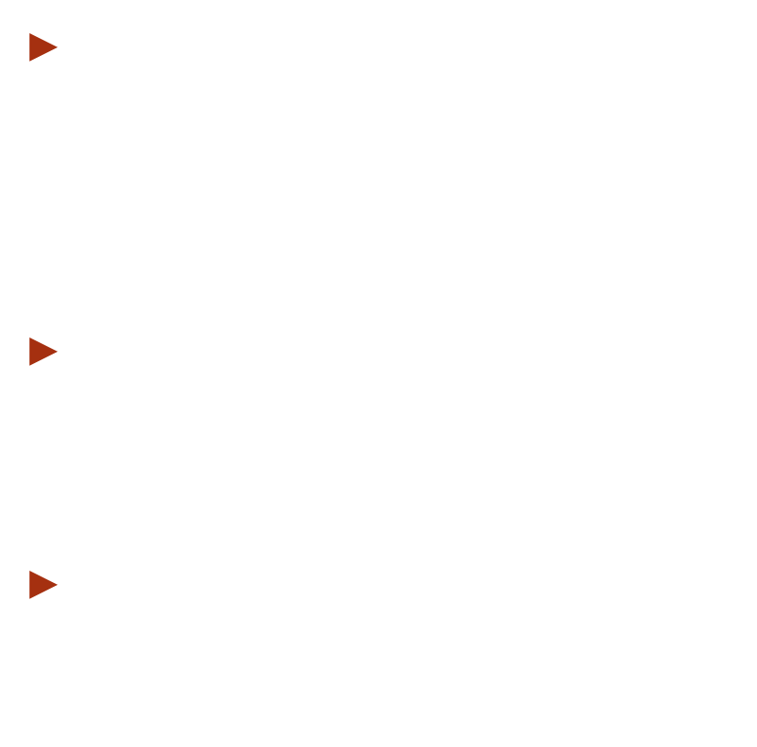
Generation of Inter-Edge Connectivity between Multiple Meshes
Fusion of multiple data from calibrated sensors
Use kNN search for possible inter connections between all points of the given pair of points clouds → Long time!!!
Search between boundary of one cloud and the nearest points of other cloud → lesser time
These connections should have Euclidean distances < $ε_{inter}$
Connections between multiple meshes
Notes:
In case of multiple sensors, multiple meshes need to be connected to form one single mesh. This is achieved using inter-edge connectivity
In common world frame, all point cliuds are transformed and aligned. The connections between multiple meshes are computed thorugh kNN search between boundary of one cloud and the nearest points of other cloud

Slide 6
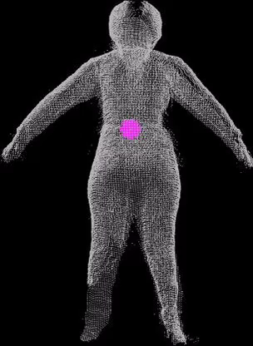
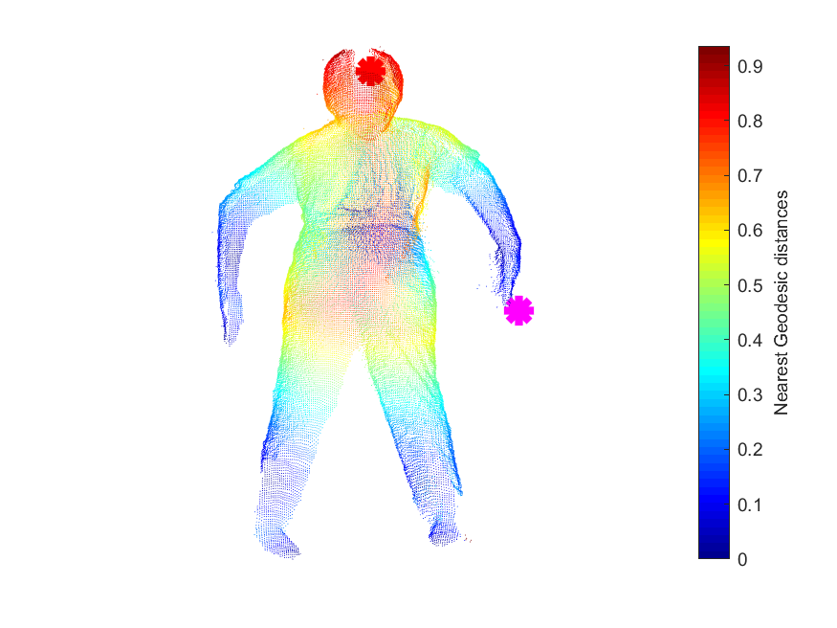
Feature extremity detection in Geodesic Mesh
MAX
Geodesic distance from current node
MIN
Notes:
With the complete connectivity lists between multiple point clouds, a final geodesic graph is created thereby overcoming the effects of self-occlusion. From the fused geodesic graph, a set of five feature extremity vertices are extracted. . To locate these extremities, an iterative process was developed which starts from central vertex $v_{C}$ of the EDG and computes and accumulates feature extremity vertices $v_{f}$

Slide 7
Detection of Feature Extremity
3D Topological Hierarchical Segmentation and Skeleton Generation
Classification of Key Body Extremities

Slide 8
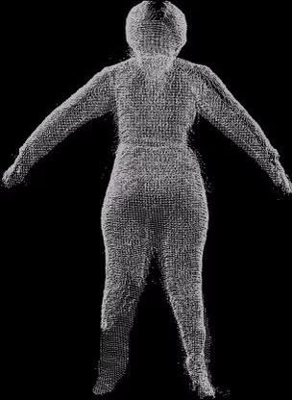

Geodesic Mapping from Feature Extremities
MAX
Calculates geodesics distance value $f_{m}$ of each vertex to the nearest feature extremity
Reveals interesting topological parts
Geodesic distance from current node
MIN
Notes:
Here, geodesic mapping function computes the geodesic distance of each point cloud vetex to the nearest feature extremity.
Finally, it reveals interesting topological parts

Slide 9
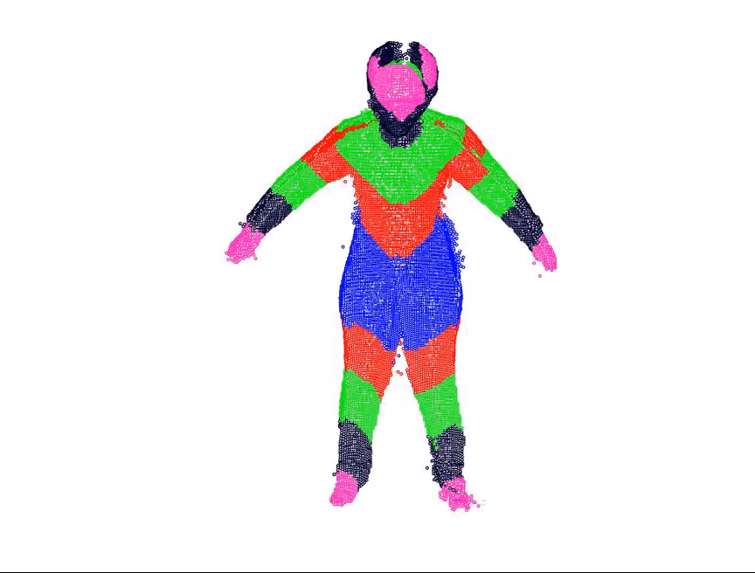

Five Topological levels formed from five defined $f_{m}$ ranges
Notes:
These topological levels can be divided into 5 subgraphs which can further be segregated into connected components that are body part clusters

Slide 10
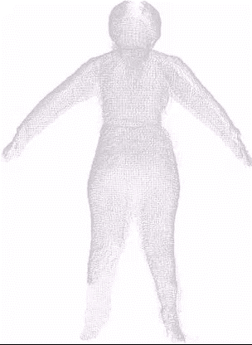
Topological Clustering
Hierarchical Skeleton Tree
Notes:
As the clusters are generated in orderly fashion, the topological nodes are generated to eventually form a hierarchical skeleton.
In Previous approaches with Pixel-wise classifications would require larger number of datasets. Over here we simple clusters the points and then classify them into key body parts thereby reducing the need for large training datasets
[11] 30k for each tree (1 mill.), [12] 3.9 million

Slide 11
Detection of Feature Extremity
3D Topological Hierarchical Segmentation and Skeleton Generation
Classification of Key Body Extremities

Slide 12
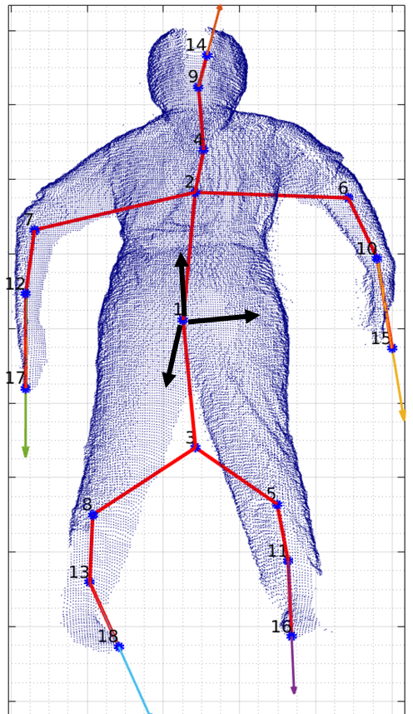
Classification of Key Body Extremities
Key extremity: H, RH, LH, RF, LF
3 kinds of direction vectors formed
Orientation vector
Local covariance matrix
Global component unit vectors
Various set of features extracted for each extremity cluster:
SVM learning model was used for classification
Notes:
At this stage, it is possible to use hierarchical skeleton for HPR. However, it is found that the order of key extremity nodes in the pose feature vector varied in each dataset. Hence, we label key extremity body parts by apply SVM over its spatial features.
“Head (H), Right Hand (RH), Left Hand (LH), Right Foot (RF) and Left Foot (LF).
With this knowledge, the correctly ordered feature set would be capable of distinguishing between various poses.
Median, Max, Min, STD along 3 dimensions, Eigenvalues of local covariance matrix, angle measurement b/w dir. of high variance of the cluster and its orientation vector → Extremity parts
The poses of the extremity cluster w.r.t the global component vectors → symmetry of the body
Fed to SVM classifier cubic kernel model . Its hyper-parameters and weights are computed by cross-validation over training data. Finally, this model is used to discriminate five key body extremity clusters into the desired classes. These labeled key extremity nodes of the skeleton model can then be used in another feature set for classifying posture recognition.

Slide 13
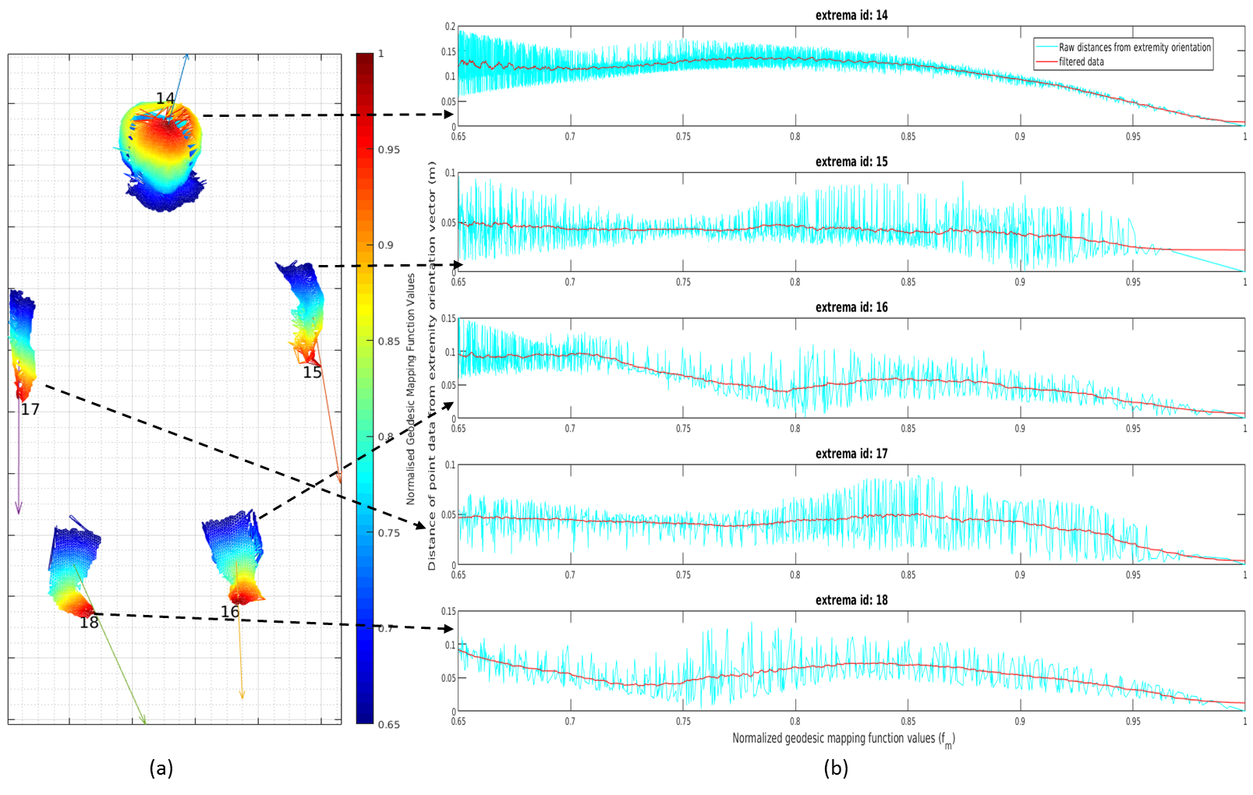

Slide 14
Evaluation in synthetic UBCV3 dataset
It contains 3.4 million depth images of human poses from 3 simulated sensor.
The complexity of the dataset: Easy and Hard
Compared the performance against the pixel-wise classification from Shafaei16 [13]
Classifier Model | Easy-pose dataset 10k postures 1 character |  | Hard-pose dataset 100k postures 16 characters
 | Train | Test | Train | Test
Proposed | 3x4000 | 3x3000 | 3x4000 | 3x3000
Shafaei16 | 2 million |  | 704k
[13] A. Shafaei and J. J. Little, “Real-time human motion capture with multiple depth cameras,” in 13th Conference on Computer and Robot Vision (CRV), 2016 , 2016, pp. 24–31.
Notes:
To evaluate this proposed calissifer, its performance is compared against the groundtruth data of publicly available UBCV3 synthetic dataset as well as the CNN model made available form the same research group.
“Depth map with corresponding grountruth poses are provided by simulated sensors
Shafai does 43 classes-> clustered to specific classes
Proposed algo processed each frame od dataset from thre sensors in 1.02s
Hard Pose: pose variation and physical sizes

Slide 15
Classifier Model | Average Accuracies (%)
 | Easy-Pose
 | H | RH |  | LH | RF | LF | Overall
Proposed | 97.9 | 88.4 | 88.9 |  | 82.5 | 83.9 | 89.4
Shafaei16 | 93.9 | 81.4 | 82.2 |  | 87.8 | 89.5 | 87.9
 | Hard-Pose
 | H | RH | LH |  | RF | LF | Overall
Proposed | 93.7 | 76.1 | 80.3 |  | 76.3 | 73.8 | 80.1
Shafaei16 | 91.6 | 73.8 | 72.4 |  | 75.5 | 75.3 | 78.0
Notes:
This table compares the classification performance of the proposed model and CNN model [25] in terms of classification accuracy rates of key body extremities on test dataset.
As you can see, our proposed model has fared well against the CNN model in overall performance.
“pixel-wise vs cluster wise: more data, lesser data, classify/combine, combine/classify, maintainig integrity
Higher Complexity-> lower overall performance
Could be improved by adding more features->computation time in learning those features”

Slide 16
2 metrices to analyze the localization of detected key body extremities w.r.t ground truth positions:
Mean Error :
Ground truth classifier output → 0.045m
Proposed classifier output → 0.058m
Mean average Precision:
At 15 cm threshold
Ground truth classifier output → 97%
Proposed classifier output → 90.1%
Notes:
To further analyze the localization of detected key body extremities w.r.t ground truth positions, two types of metrics are used: mean error and mean average precision at the threshold
The gap between groundtruth output and proposed output is due to classification errors.
“Mean: average Euclidean distance between the estimated and ground-truth 3D locations of the key body parts
The difference between the two types of outputs is due to classification errors from the proposed model. The closer the gap, the better the performance of the proposed algorithm
Precision fraction of predicted key body parts that are within the threshold distance of the ground truth.
Since the errors in ground truth annotations of poses from easy-pose UBCV3 and the ground truth pose 3D skeleton is very different from the proposed hierarchical skeleton tree graph, it is best to just report the mean average precision at 0.15 m threshold

Slide 17
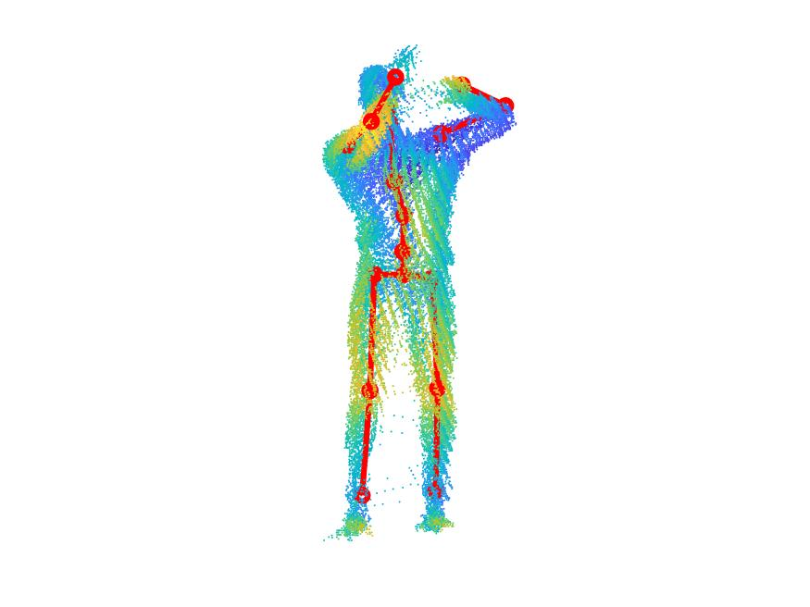
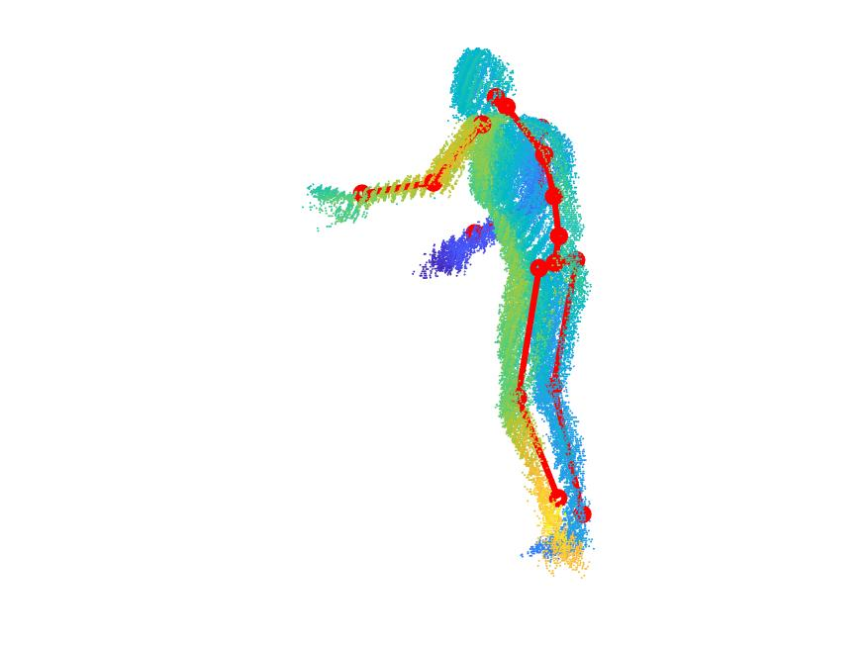
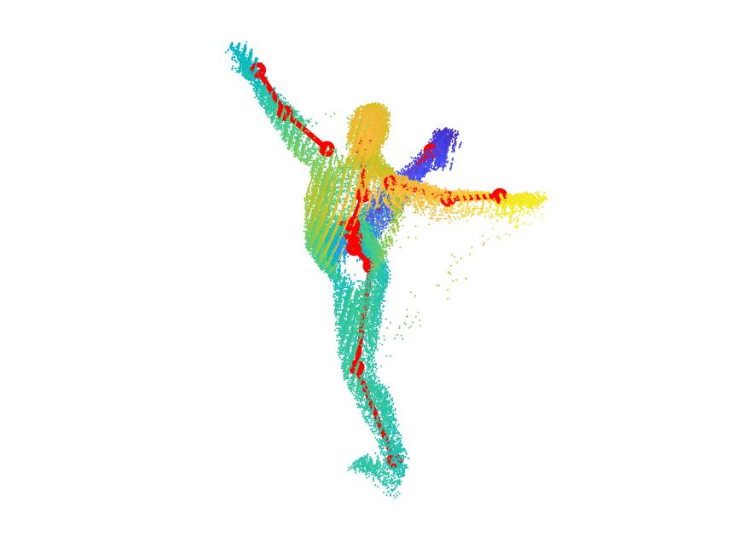
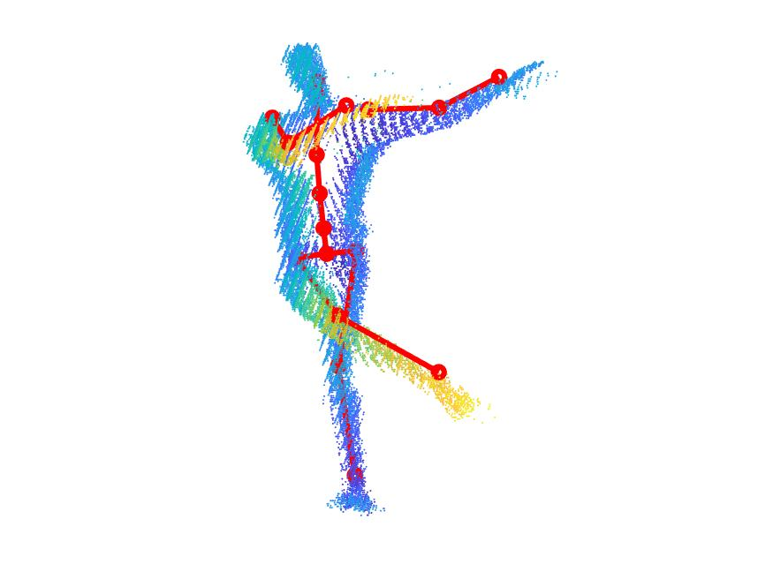
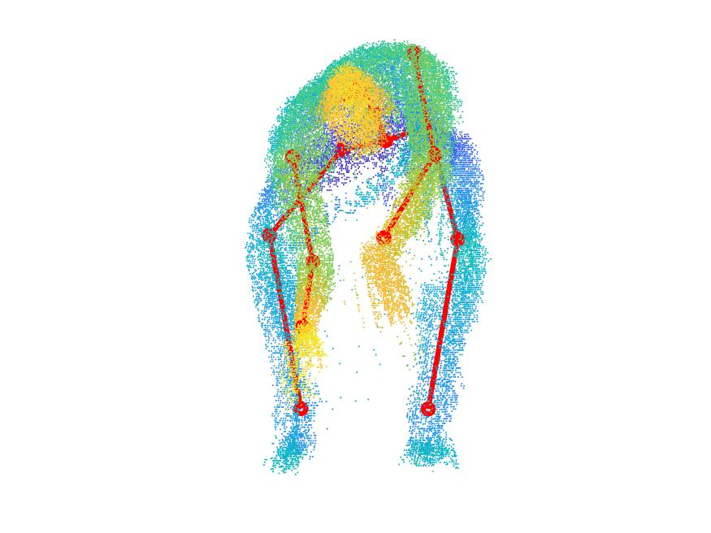
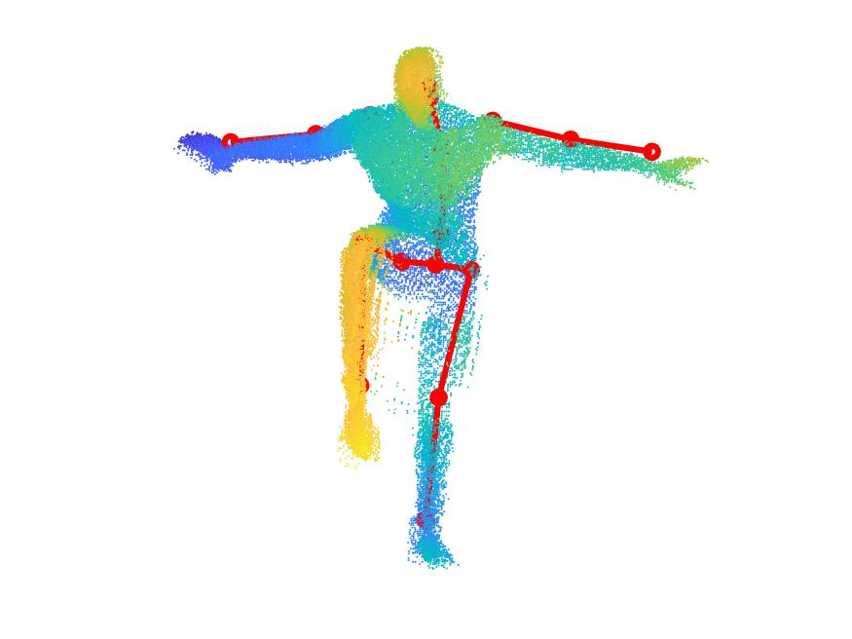
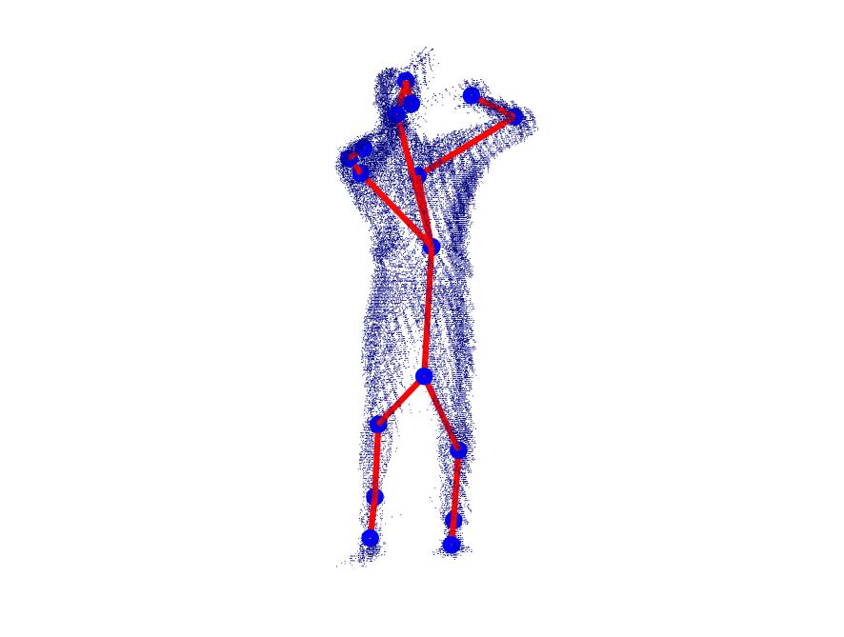
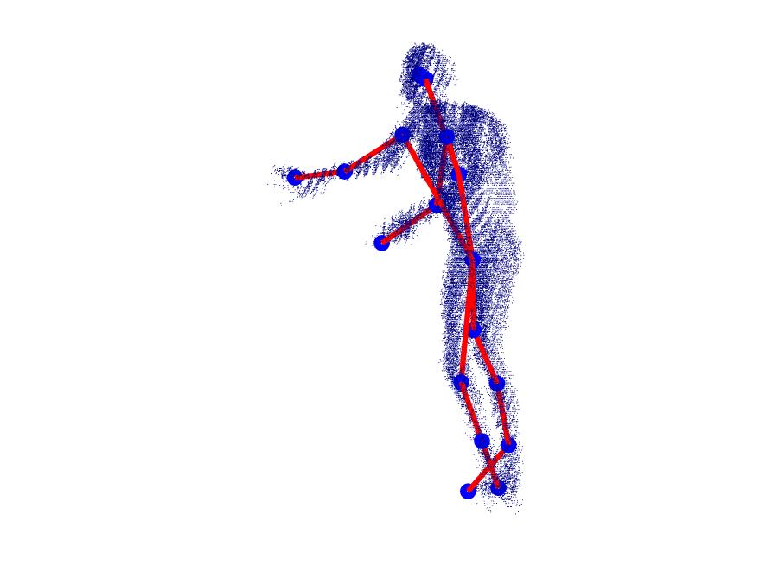
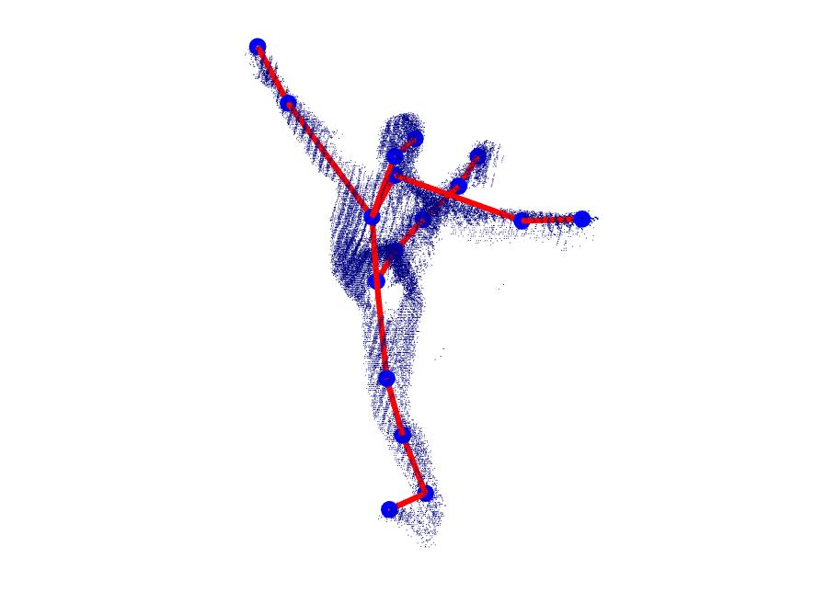
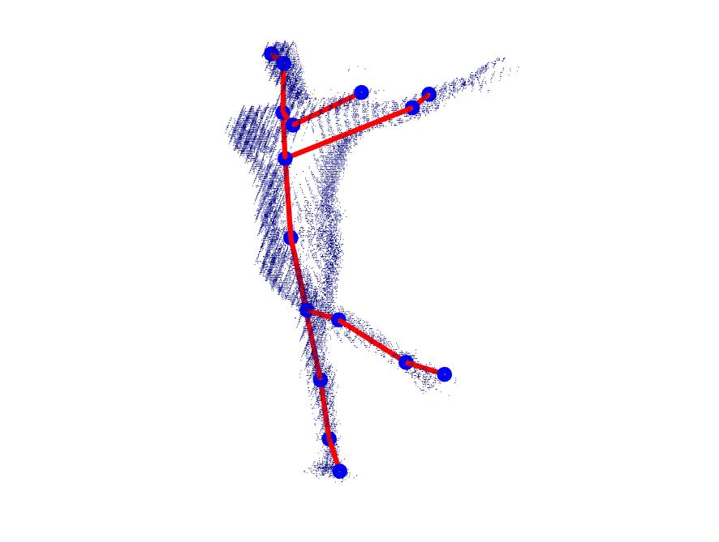
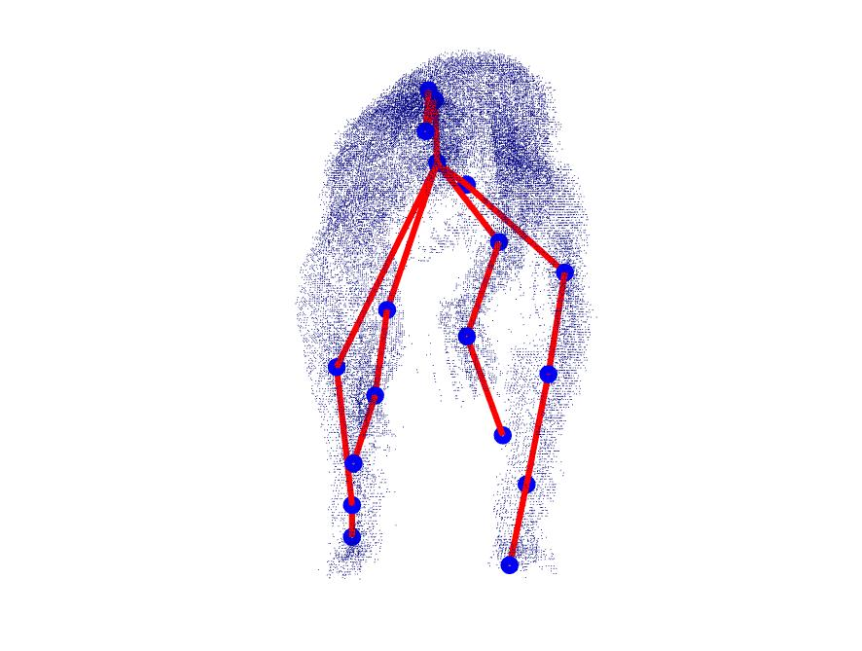
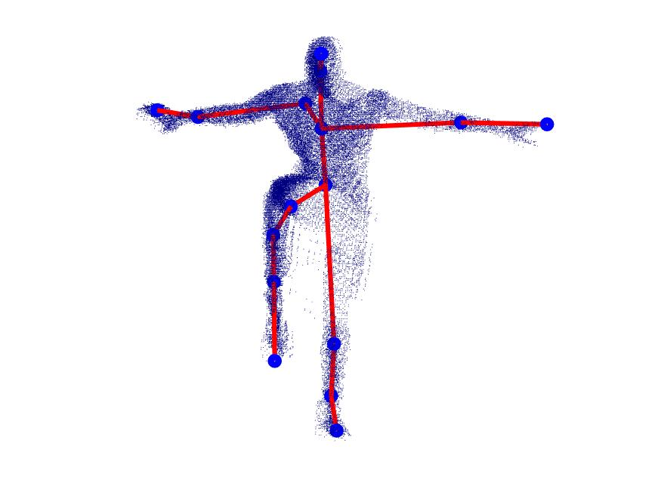
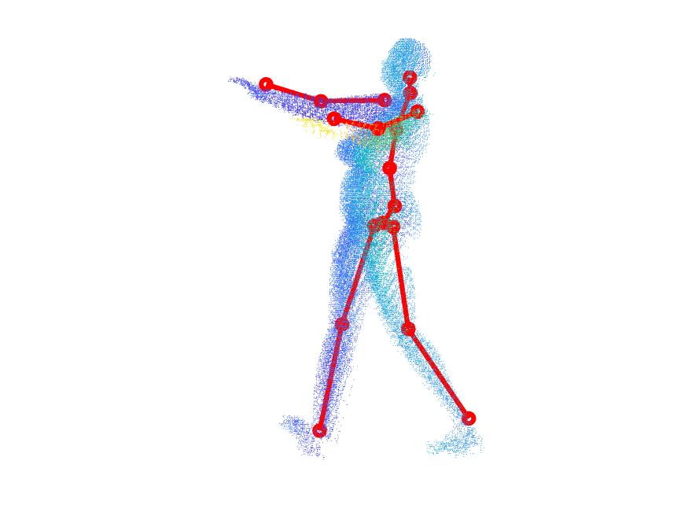
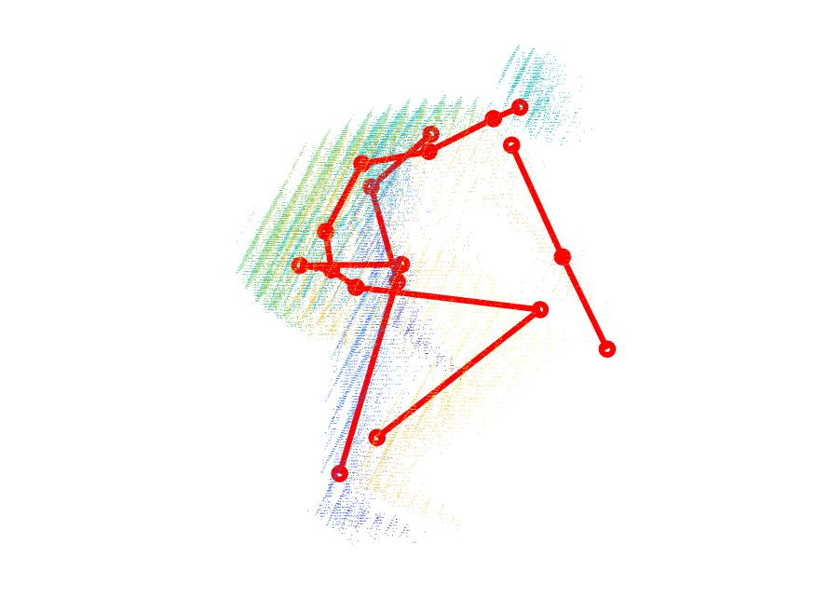
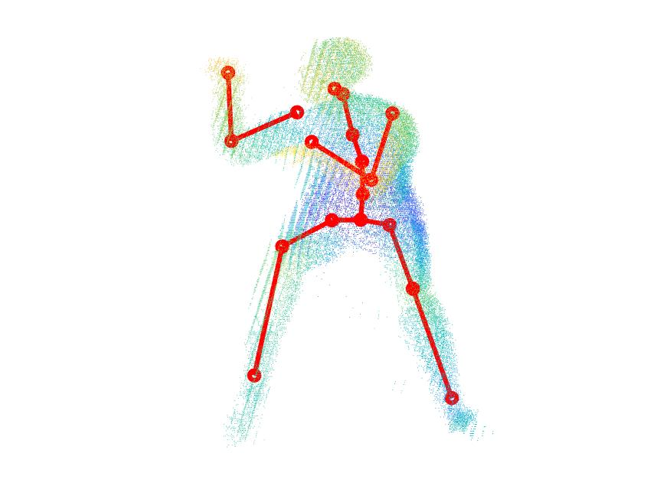
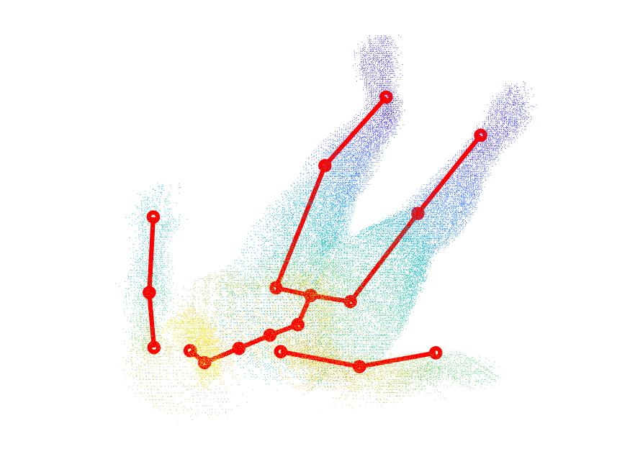
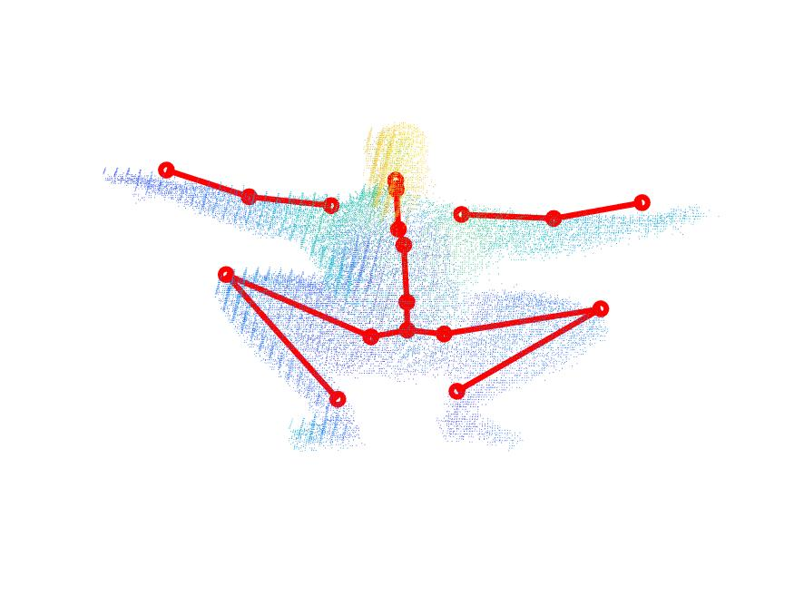
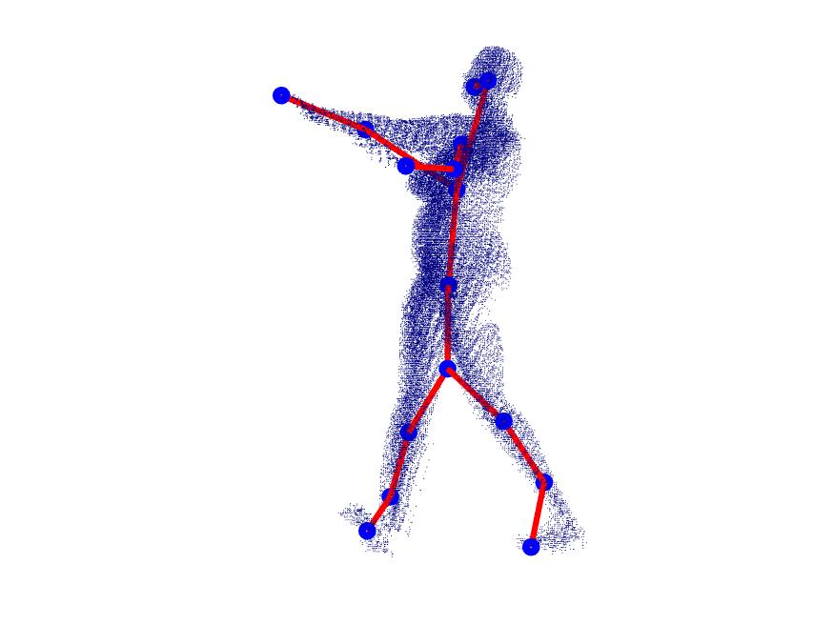
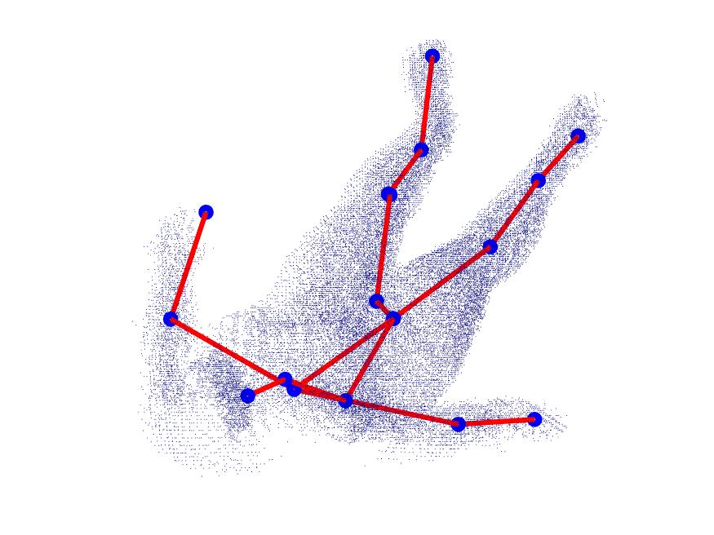
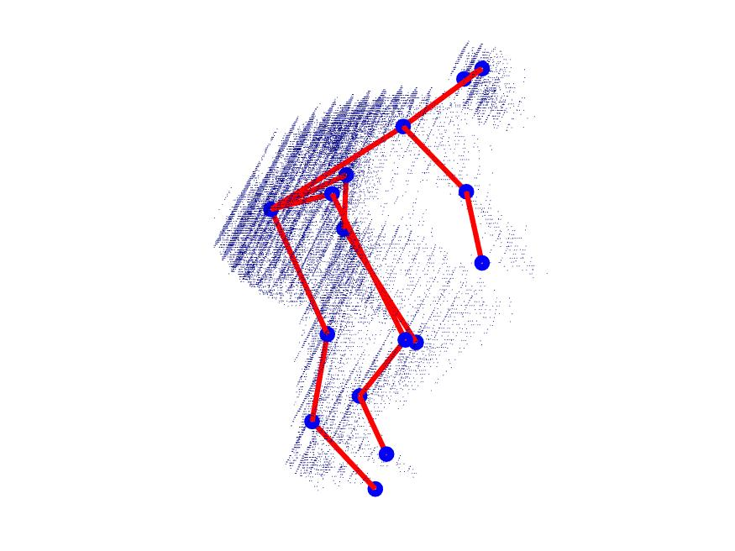
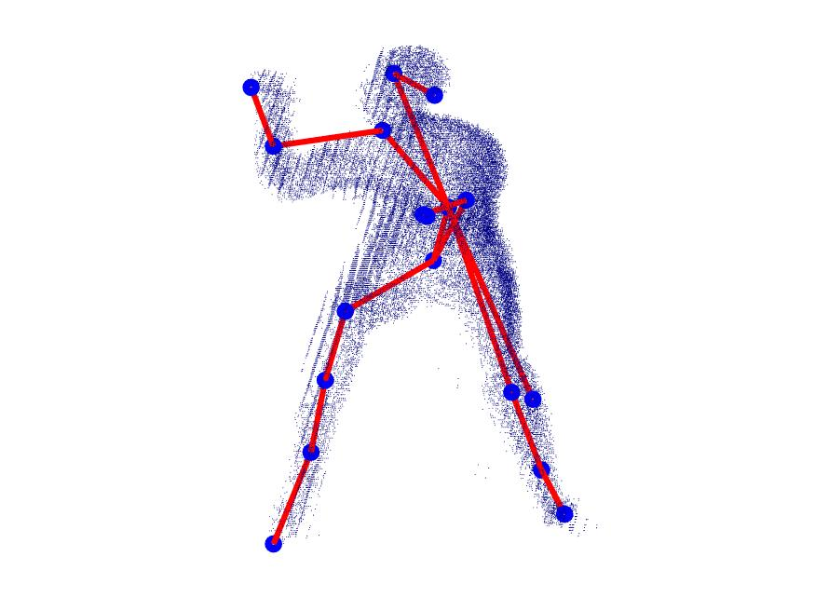
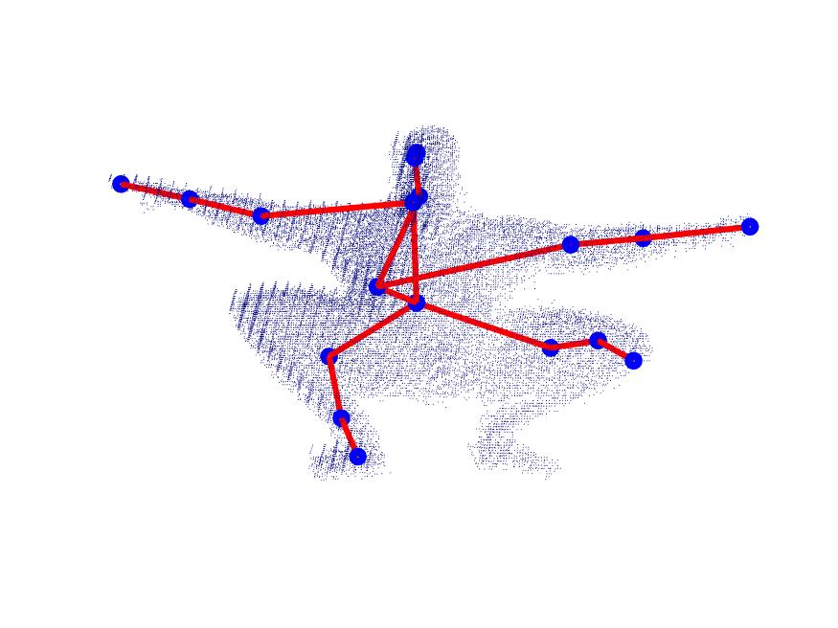
Ground Truth
Easy Body Poses
Proposed
Ground Truth
Hard Body Poses
Proposed
Notes:
Following are the Qualitative Examples of proposed pose models which are compared against gronuth poe model from UBCV3 dataset.
Point which is which
Its to be noted that the hard-pose dataset contains a variety of body poses performed by different characters.
Finally, these labeled key extremities along with generated hierarchical skeleton can be use in HPR
“Here are the Qualitative Examples of pose models from UBCV3 dataset: Easy-pose dataset with a) ground truth skeleton model b) proposed hierarchical skeleton tree model, Hard-pose dataset with c) ground truth skeleton model d) proposed hierarchical skeleton tree mode. Note that the hard-pose dataset contains a variety of body poses performed by different characters. Filled red circles represent the joints for ground truth skeleton. Filled blue denote circles topological nodes for the proposed hierarchical skeleton

